Slide 1
Data Collection and Preparation for Currency Adaptation
Applied Data Science in an Industrial Banknote Image Recognition Framework
BTI7302/FS21
Sophie Haug

Slide 2
Outline
Introduction/Initial Position
Project Goals
Project Methods
Challenges
Conclusions/Outlook
Notes:
This is the outline for my presentation

Slide 3
Introduction
Currency Adaptation: Development of software (Currency Data Files), which enables a banknote reader to process, classify and validate all banknotes of one currency
CDFs are developed and tested in MCM (Move Currency Modeler)
Desktop application for analyzing banknote raw data and developing CDFs
In the background: algorithmic framework
Notes:
First I want to explain what Currency Adaptation is
MCM is the hub and pivotal point of the adaptation specialist’s daily work
With the algorithmic framework in the background of MCM, we can simulate the banknote reader algorithms for: classification, tape detection, authenticity markers etc.

Slide 4
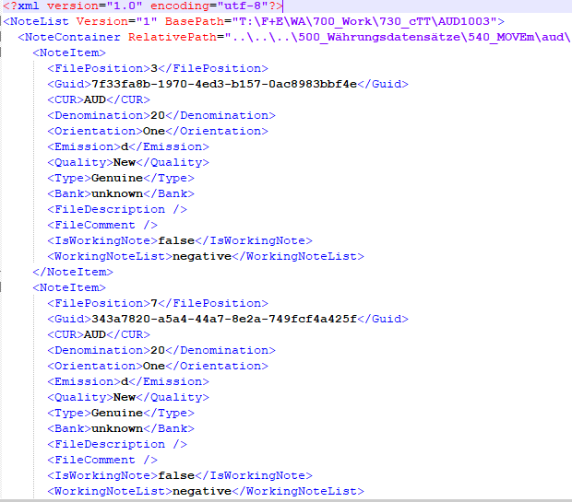
Introduction
Requires the availability of banknote raw data
Today: a centralized Data Lake in the proprietary Cloud
Cloud-based Microservice architecture (REST) for accessing and managing the Data Lake
Banknote Raw Data: NIF (Note Information File): binary file storing Metadata, Note Data and Images
Immutable
Notelist Format: XML format for managing and persisting individual note (records) from NIFs
Notes:
The work of currency adaptation requires…
The cloud based Microservices MFX and MDS – which I will get into detail about in a minute – have been introduced over the last two years and today constitute fundamental tools for the collection of note data
Notelistfile offers a way to persist sets of Notes across individual NIF files in a text-based format. It’s the de facto standard used by Currency Adaptation specialists today.
In a Notelisfile, notes from various NIF sources can be grouped together and loaded into MCM directly. In MCM they will also be kept and managed as a Notelist.
Typical example is that an adaptator will keep all the EUR trainings data in one Notelist when working on a new EUR CDF.
Notes can be directly loaded into MCM via Notelistfile. Users can generate new Notelists in MCM and export them.

Slide 5
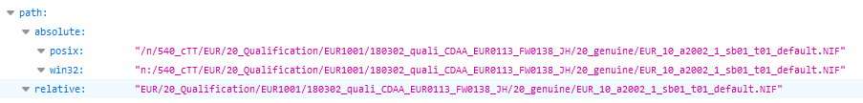
MFX (MOVE File Index)
Unique File ID (MD5 checksum) for every file
Look up path(s) in Data Lake for a given File ID
GET mfx/api/v1/file/75FFAE2B2CB4ACDF4E02F43CEBAADE76
Notes:
The name says it all: Lookup of file locations based on a file’s unique ID
Shows us the path/location of a file in the Data Lake

Slide 6
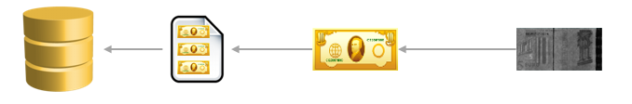
MDS (MOVE Data Service)
Get the actual NIF data from REST API
Unique ID for every note File ID : File Position -> E8059CE40815ED06093705F4D353D49B:1
3-tier model (enables lazy loading!):
Nif
Note
Image
GET mds/api/v1/nif/E8059CE40815ED06093705F4D353D49B
GET mds/api/v1/nif/E8059CE40815ED06093705F4D353D49B/note/1
GET mds/api/v1/nif/E8059CE40815ED06093705F4D353D49B/note/1/image/1
Notes:
Purpose of MDS is to get the actual data in the NIFS from the Data Lake as JSON via a REST API.
It has a Database in the background storing all data from all NIFs in the Data Lake

Slide 7
Initial Position before Project Start
No authoritative reference data sets used in CDF development
Limited usage of the possibilities offered by MFX/MDS, also due to lack of dedicated tools
Lack of consistent note annotation. «Labeling» is an act of interpretation done by the adaptation specialist
Based on filename of a NIF (generated at recording time)
Based on annotation within the NIF (made by a recording tool)
Based on a Notelistfile («EUR_5_counterfeits.nl») that somebody else made
Notes:
Let me name some of the «pain points» which caused me to take up this project
1: Everyone basically uses their own sets. The use of training and test data however influences the outcome of the CDF. The data used are not centralized or governed or even transparent
2: MFX/MDS open up new possibilities in the handling of the data but these are sparingly used by adaptators. People are used to the circumstance that you have to parse the entire file everytime you want to look at a single note record
3. labeling:

Slide 8
Project Goals
Annotated Reference Data Sets
Accurate
Consistent
Complete
Define Methods for generating Data Sets according to context-dependent criteria
According to filter criteria specified by the user, e.g. «Give me all EUR 5 suspected counterfeits»
Persist Data Sets in a lightweight, flexible way
Independent of file locations/paths
Making use of the advantages of MFX/MDS

Slide 9
Project Methods
NoteSet: new Data Container for referencing and persisting sets of Note Data
Convertability to/from Notelistfile format is necessary
Python library: pynoteset
Implement NoteSet Data Container in the main adaptation tool MCM
Process definition and implementation for automated NoteSet Generation
Using Jupyter Notebook
Making use MFX and MDS REST APIs, as well as the pynoteset library
Notes:
Pivotal point

Slide 10
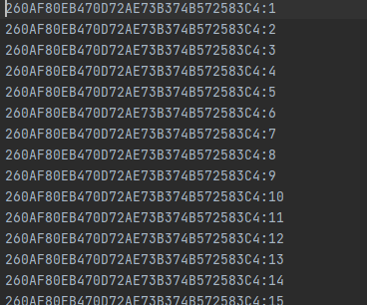
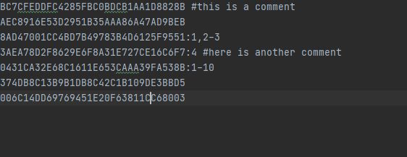
The NoteSet Data Container
File ID: MD5 Checksum of Nif file: E8059CE40815ED06093705F4D353D49B
Note ID: File ID:File Position:
Not a new Data Format, rather a new paradigm of how to think of Note Data sets: sets of Note IDs
Set operations: NoteSets should be easily mergeable, intersectable and comparable
Save in ASCII format, allow for shortcuts in serialization (.ns)
Equivalence Classes with respect to annotation
Only one annotation for the entire set

Slide 11
NoteSet Annotation
NoteSets are equivalence classes -> only one annotation per set.
Idea: Store the annotation in the filename of the .ns file
Challenge: Which information to store in the annotation?
Mandatory: Necessary to identify a particular type of note in MCM uniquely
Optional: Not identifying, but likely to be used in filtering

Slide 12
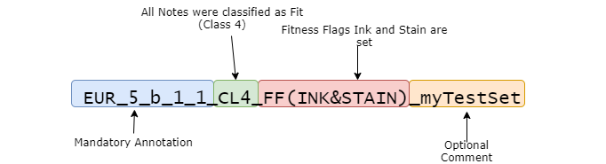
NoteSet Annotation
Regex Definiton for filename-based NoteSet Annotation
([A-Z]{3}){1,2}_(([0-9]*[.])?[0-9]|X)*_([a-z]|X)_([1-4]|X)_([1-9]+|X)(_CL[1-4])?(_SF\(([A-Z_0-9]+)(&[A-Z_0-9]+)*\))?(_FF\(([A-Z_0-9]+)(&[A-Z_0-9]+)*\))?(_[a-zA-Z0-9]*)?
Example of valid NoteSet Annotation String:

Slide 13
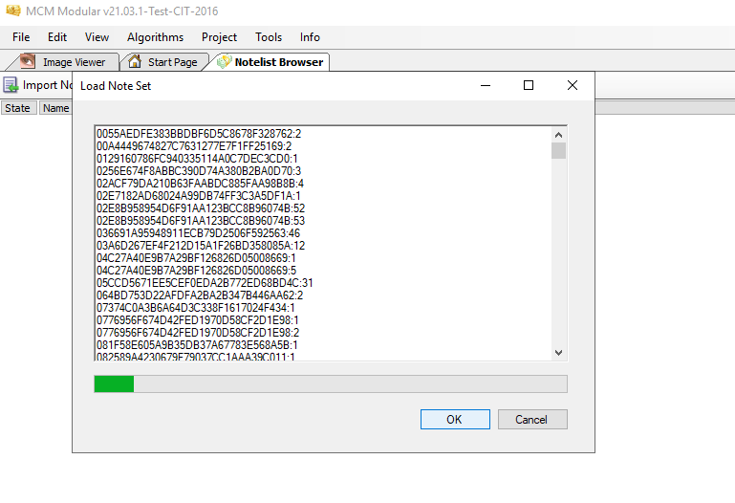
Integrating NoteSet Data Container in MCM
Add a minimal Viewer which allows loading of NoteSets via copy-paste
NoteSet is preprocessed and referenced Notes loaded from MFX via NoteID

Slide 14
Automated Generation of NoteSets
Extract a number of typical/likely use cases and develop Jupyter Notebooks based on that use case
Benefits of using Jupyter
Allows expert users insight into the technical background of NoteSet generation
Fast implementation, «prototypical» character
Notes:
Jupyter: idea is that it could be beneficial for some adaptation specialists to look into the code since they are themselves data specialists in some sense. Some of them have presented themselves to be interested in working with Jupyter

Slide 15
Use Case 1: Convert NoteSet to Dataframe and perform Data Analysis on it
Convert a .ns file (or .nl Notelist) into a NoteSet object, get notes from MDS and convert them into a pandas DataFrame
Challenge: How to flatten the nested structure of the Note object?

Slide 16
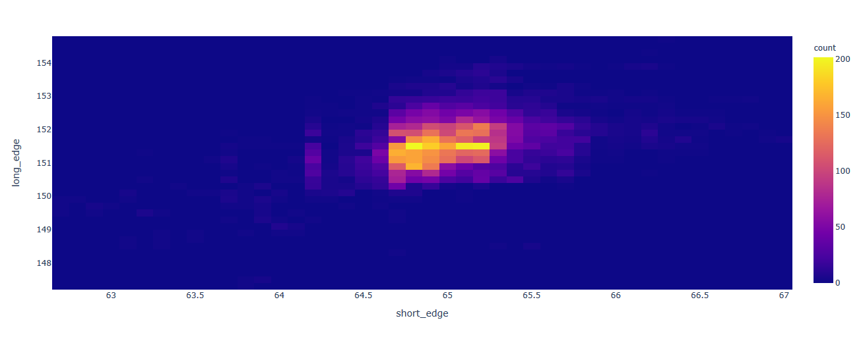
Use Case 1: Convert NoteSet to Dataframe and perform Data Analysis on it
Use standard Data Science libraries to plot, find quantiles, outliers and generate corresponding NoteSets
E.g. A NoteSet for all outliers (using z-Score) for the Note Dimension -> save and/or load directly into MCM
Plot NoteSet data (e.g. heatmap of the dimensions of all AUD 50 b notes in the Data Lake)

Slide 17
Use Case 2: Use the MOVEm Simulator and NoteSets for CDF regression testing
MOVEm Simulator: a user interface to the core application of the banknote reader firmware
Test CDFs without operating a physical banknote reader and physical banknotes
Input: Existing NIF files, CDF
Output: Level-1 NIF files (no images)
Desktop application written in Python and Qt, scriptable
Idea: simulate existing Raw Data with new CDF(s) and generate annotated NoteSets SimulationResults. -> CDF Regression testing

Slide 18
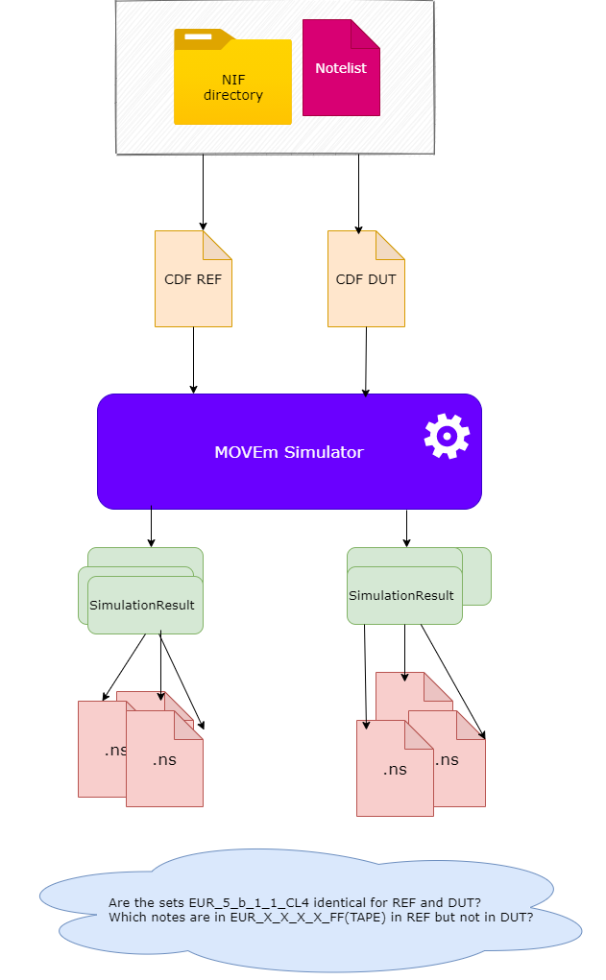
Use Case 2: Use the MOVEm Simulator and NoteSets for CDF regression testing
Notes:
Choose 2 CDFs, one as «Reference» one as «Device under Test».
Run a simulation for the same NIF data for each CDF
The SimulationResults we obtained are sorted by Classification
e.g. the Simulator labeled a Note as EUR 5 b Category 4 -> put it into the corresponding set
Generate .ns files for all NoteSets. The sets can be directly used in MCM for further analysis

Slide 19
Challenges
Scripting MCM via Python
Idea: run selected MCM algorithms on NoteSets via Jupyter
Proved to be infeasible due to limitation of Python MCM wrapper library and complexity of MCM
Performance issues:
Normally: Nif-to-Note ratio : 1/100
Tailored NoteSets (select only a few matching notes from the entire Data Lake): Nif-to-Note ratio:
→ close to 1!!!
No lazy loading of notes in MCM, for each FileID, the entire file is parsed and loaded
Probable image caching in MCM -> leads to very high memory usage and generally bad performance
Solution: Refactor MCM to allow lazy loading of notes

Slide 20
Conclusions
NoteSet data container:
Foundational element for Data Collection: annotated data container
Important: Annotation is independent of NIF and any recording tool!
Flexible, little maintenance cost, lends itself very well to version-control systems like Git
Minimalist, readable can be shared easily e.g. in JIRA, e-mail etc.
Works well with the Microservice Toolchain (MFX and MDS)
Notes:
The foundational, innovative thing about NoteSets is that it provides an annotated data container

Slide 21
Conclusions
NoteSet Generation using Jupyter
Quickly generate MCM-loadable NoteSets according to user-specific needs
Could be successfully applied in a real-world problem
MOVEmSimulator based NoteSet generation proposes a new way for CDF regression testing
Notes:
Could apply this in a real world problem which I describe in my documentation
Also the usage of Data Science frameworks on Note Data is something that hasnt been done before

Slide 22
Outlook
Extend the compatibility with the NoteSet Data Container across the toolchain
Introduce new endpoints in MDS API to get files as NoteSets (for better perfomance)
e.g.
GET mds/api/v1/E8059CE40815ED06093705F4D353D49B/noteset
would yield the response:
E8059CE40815ED06093705F4D353D49B:1
E8059CE40815ED06093705F4D353D49B:2
E8059CE40815ED06093705F4D353D49B:3
E8059CE40815ED06093705F4D353D49B:4
….
Version Controlled NoteSets in currency adaptation
Introduce CDF regression tests using MOVEmSimulator and NoteSets
Notes:
1: Especially make NoteSet compatible with the MOVEmSimulator for example
2: This is currently being discussed, it would mean a relatively simple extension to the MDS API and make the NoteSet generation faster
3: Also being discussed however general reluctance to use Git on the side of adaptation team
4: Will be presented to Adaptation Team next week as a proposition for CDF regression testing (which at this point in time does not exist yet)

